Slide 1
HIGH SCHOOL BBQ
FSTAT Conference

Slide 2
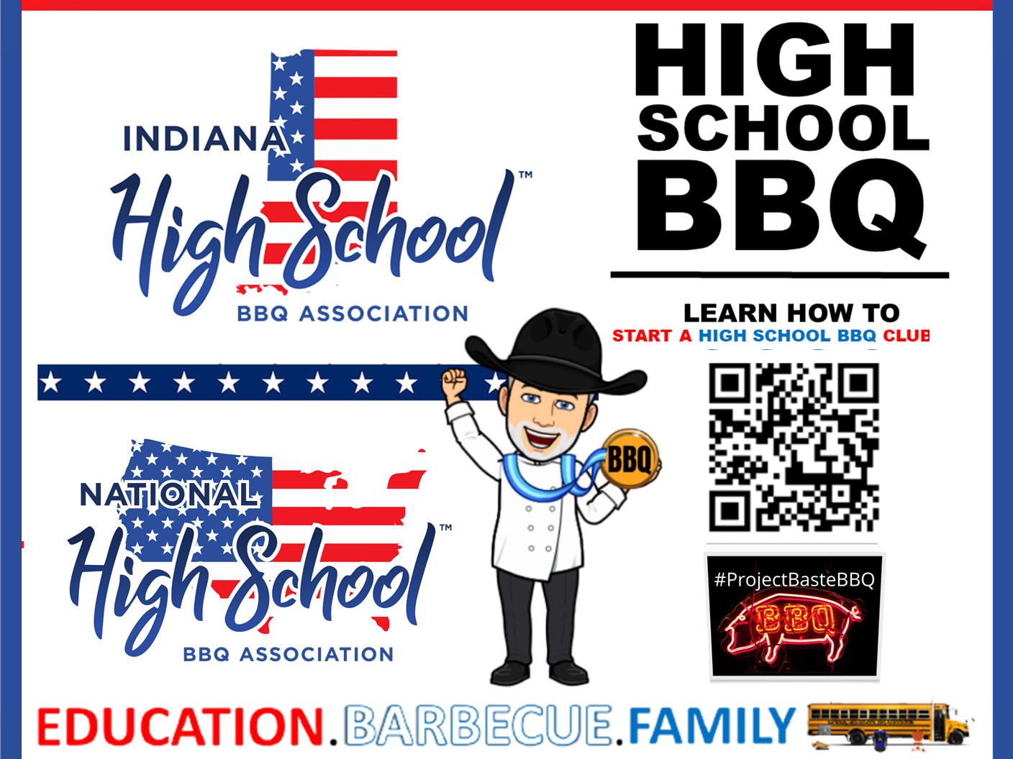
INDIANA HIGH SCHOOL BBQ
Indiana FCCLA Prostart Conference

Slide 3
Texas High School BBQ Association - TXHSBBQ

Slide 5
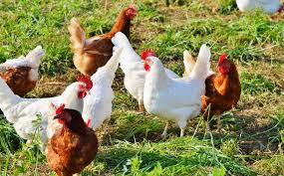
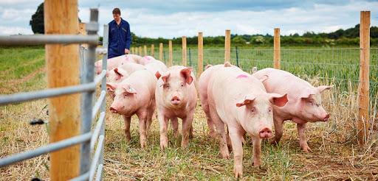
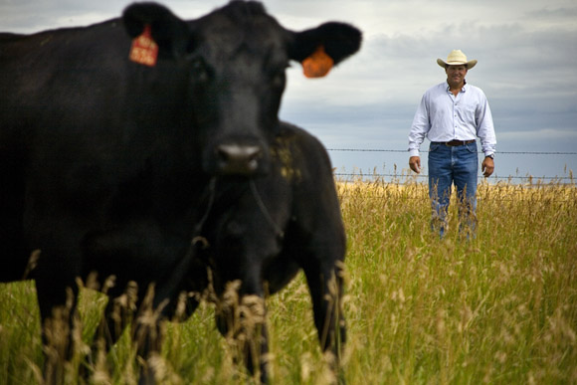
Thank you for your time today!
THANK YOU TO OUR US MILITARY, FIRST RESPONDERS, TEACHERS, AND FARMERS AND RANCHERS!
GOD BLESS AMERICA AND TEXAS!

Slide 6
March 12-14, 20Tan-Tar-A Resort & Conference Center Osage Beach, Missouri
HAPPY 60th birthday FSTAT!

Slide 11
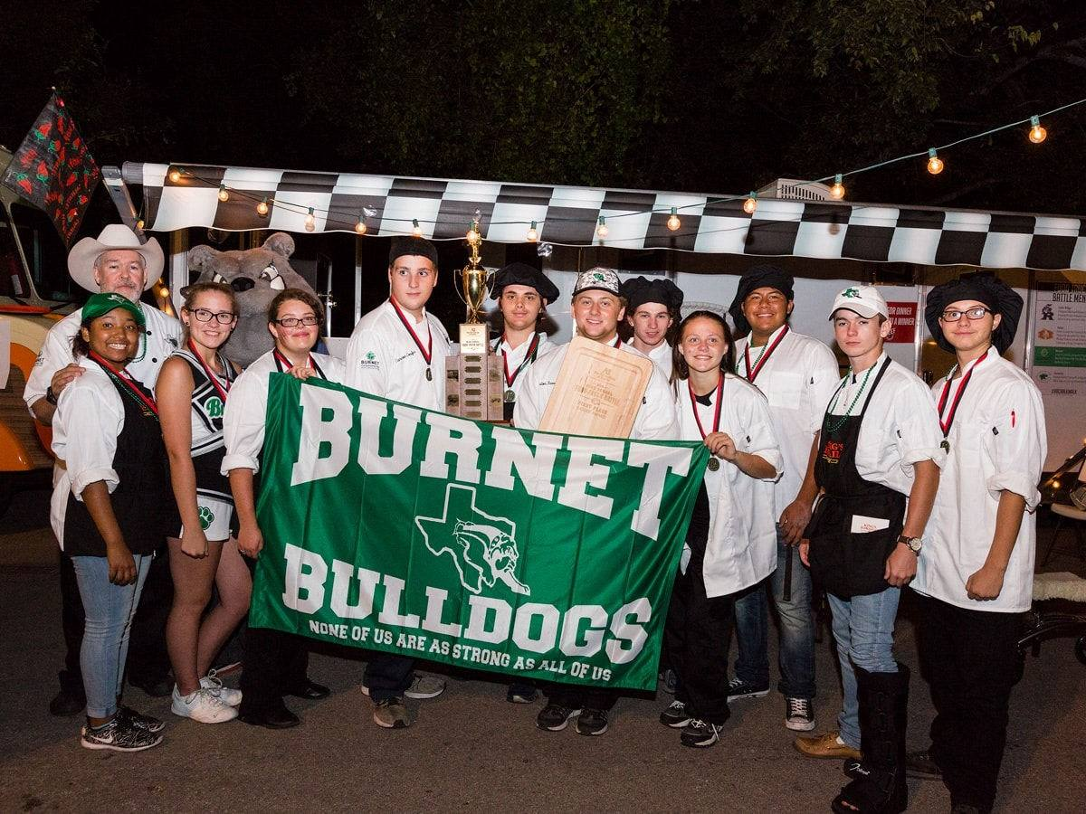
Chef Mike Erickson - Founder

Slide 12
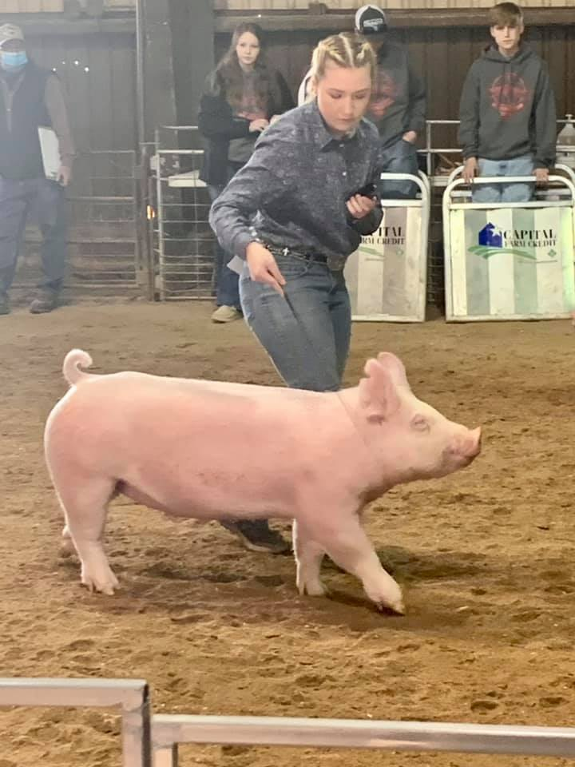

Slide 13
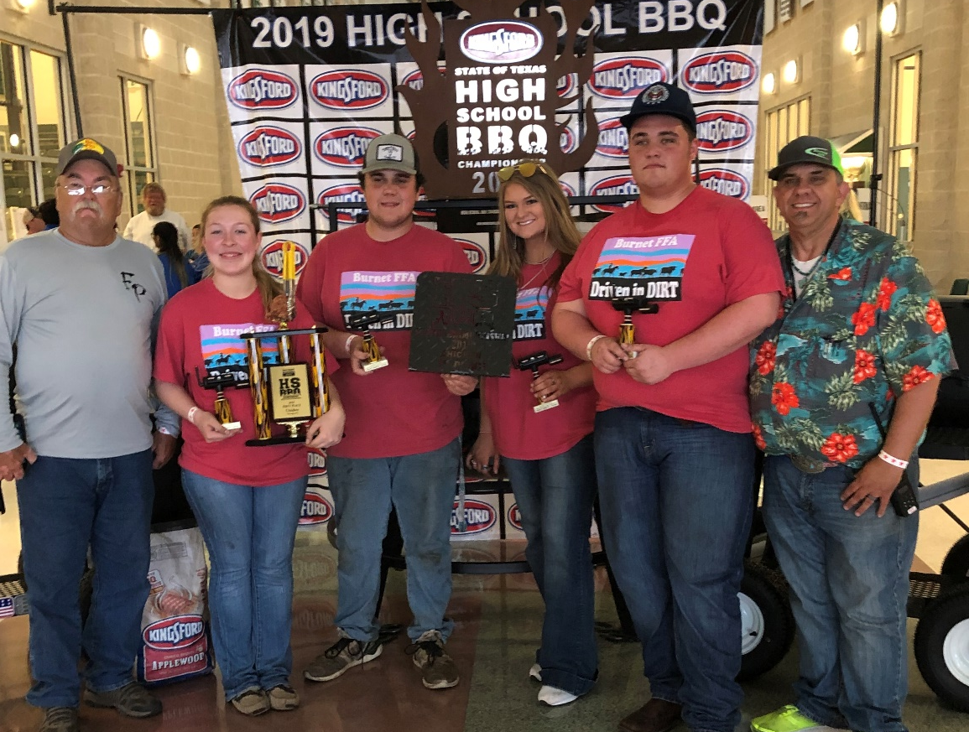
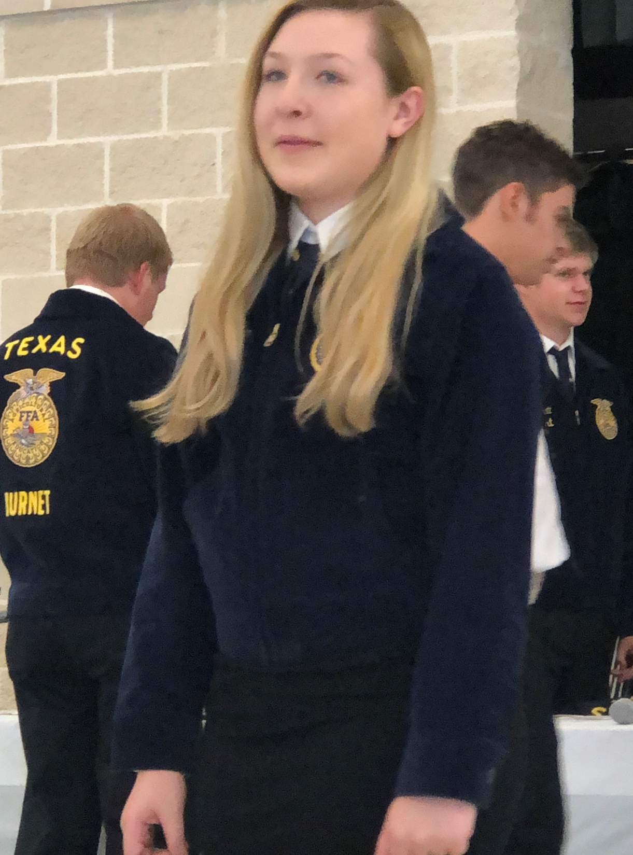

Slide 14
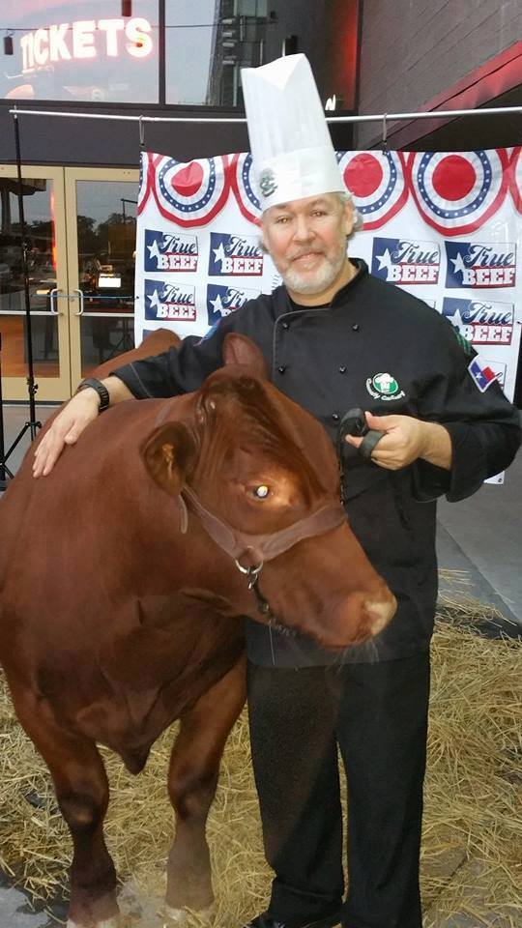
TRUE BEEF: From Pasture To Plate
A documentary film Chef Erickson inspired and was the Executive Producer of following his high school students across Texas on a year long field trip learning about beef production from pasture to plate, that included barbecue, burgers, meat quality, butchering, and sausage making designed using Project Based Learning.
CIRRICULUM THROUGH THE AMERICAN FARM BUREAU FOUNDATION

Slide 15
TRUE BEEF: FROM PASTURE TO PLATE

Slide 16
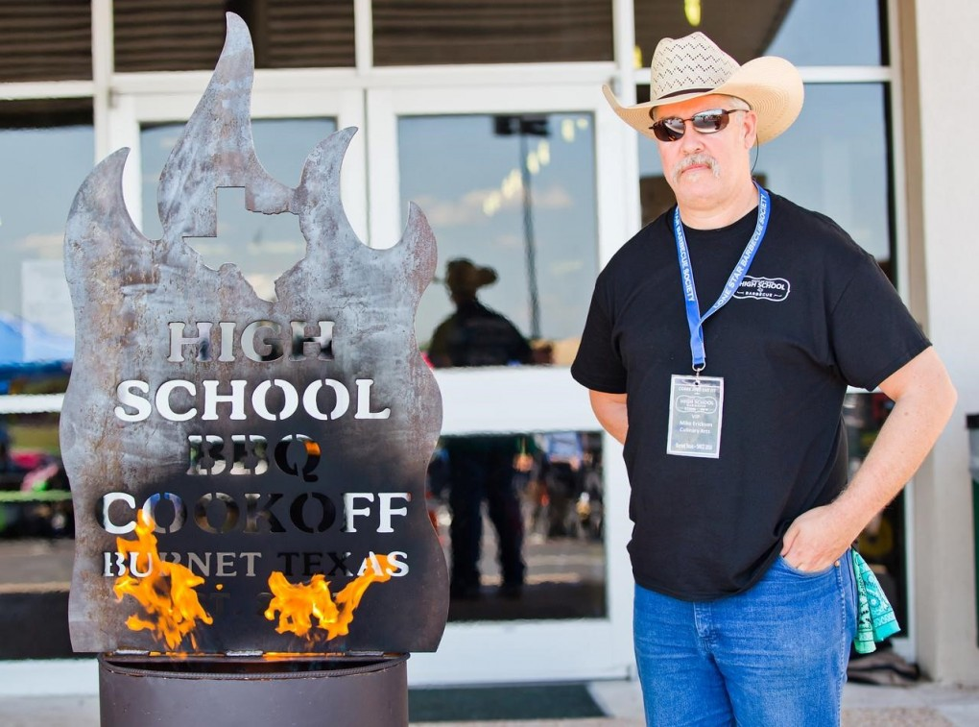
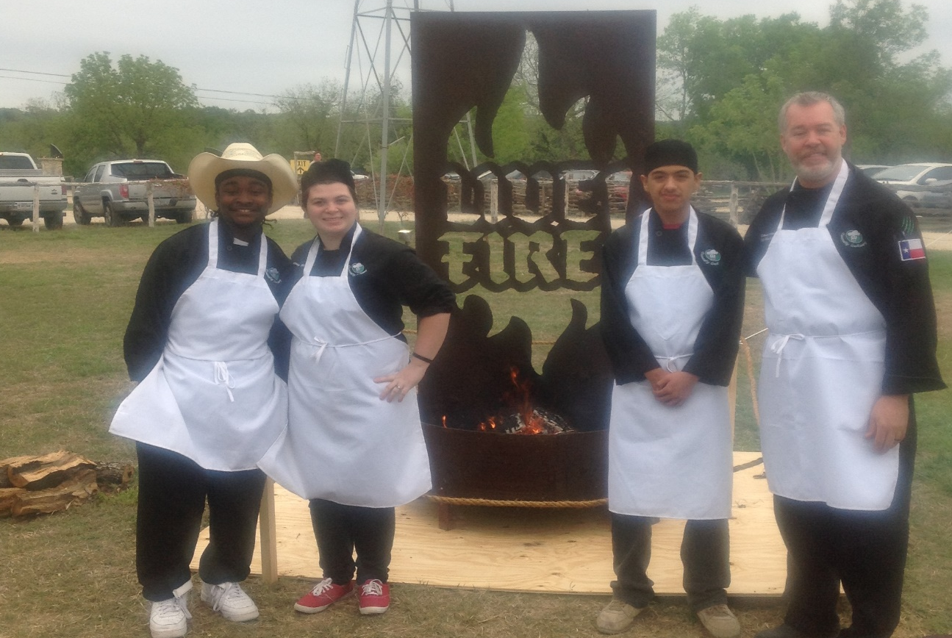

Slide 17
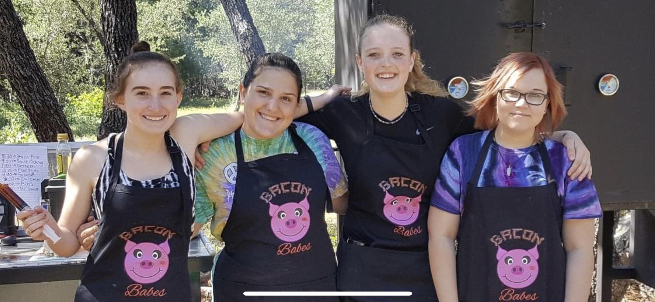
BACON BABES
BACON BABE

Slide 18
THE IRON DAWG

Slide 19
THE IRON DAWGS

Slide 22
THE DUCK BRIGADE

Slide 24
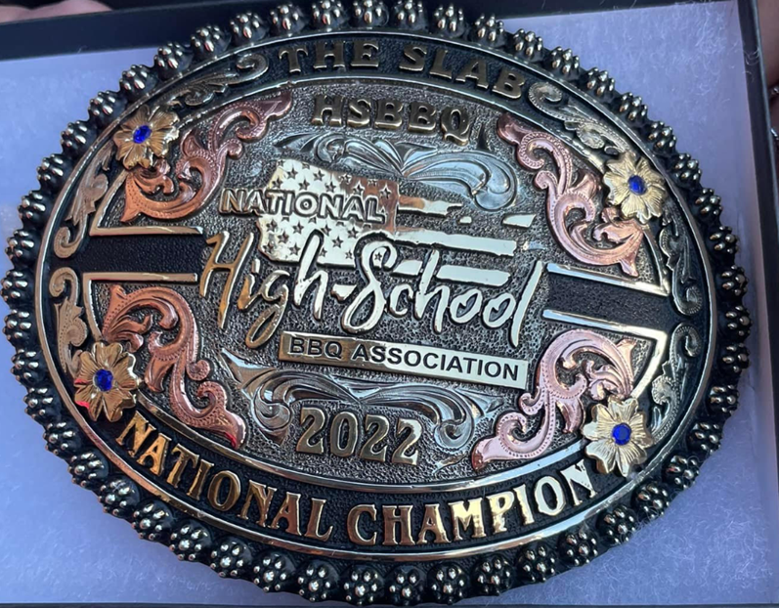
The Equipment (See our Equipment Checkoff List)

Slide 25
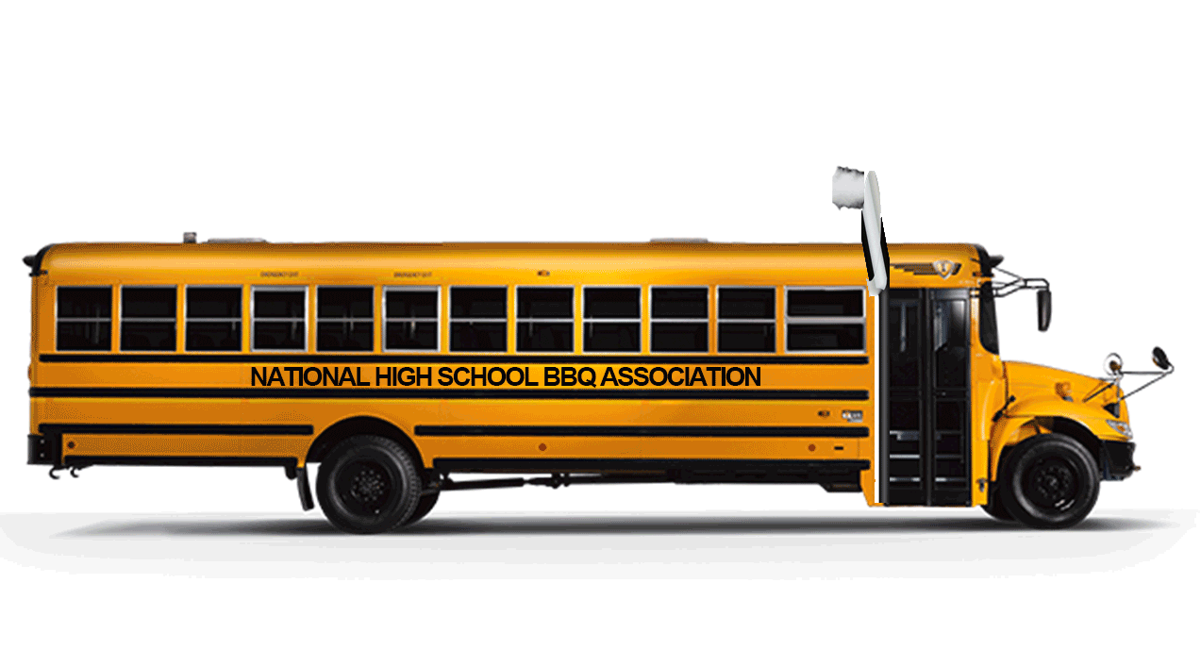
WHY HIGH SCHOOL BBQ?

Slide 26
CLICK VIDEO LINK HERE
HIGH SCHOOL BBQ IN ACTION

Slide 27
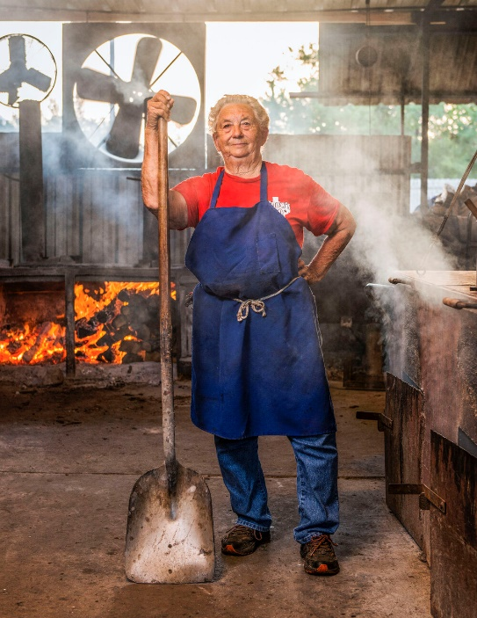
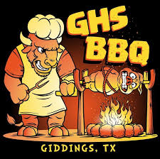
NETFLIX – Chef’s Table BBQ

Slide 29
HOW WILL YOU ENGAGE YOUR STUDENTS?
WHAT WILL THE 2023-2024 SCHOOL YEAR LOOK LIKE FOR THE CLASS OF 2024?

Slide 32
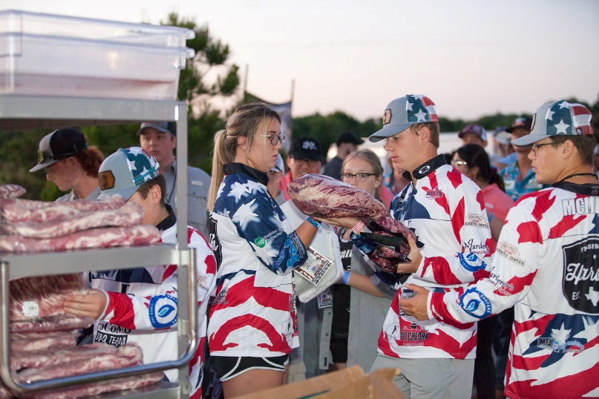
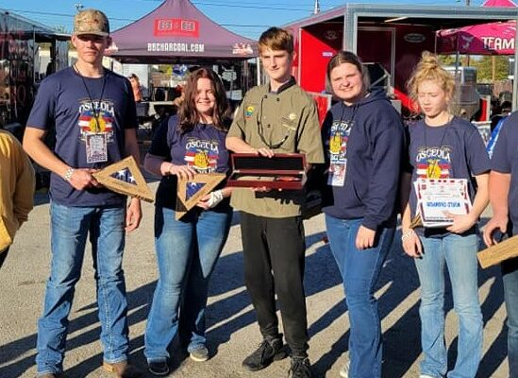
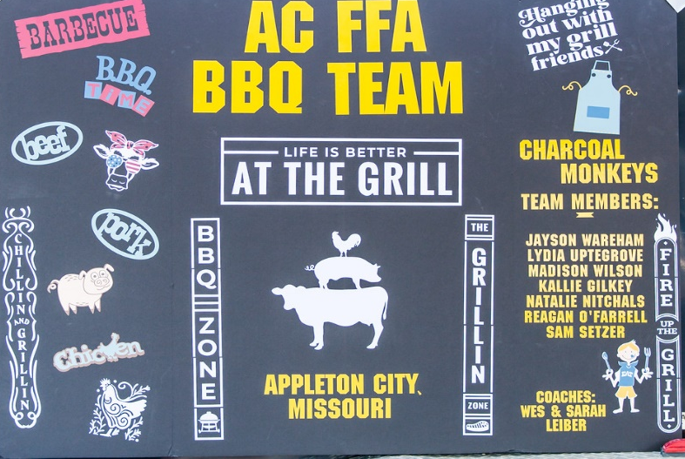
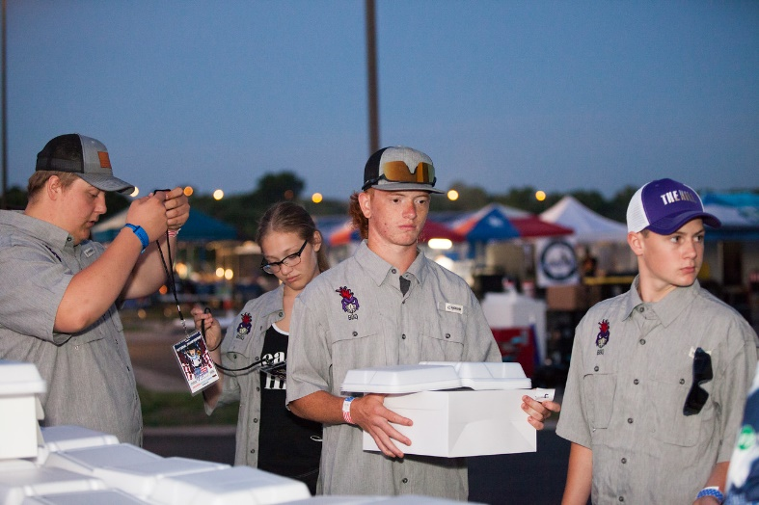
MISSOURI HIGH SCHOOL BBQ ASSOCIATION
Osceola HS FFA Muddy River Smokers
lAppleton City Charcoal Monkeys
Smithton Train Smokers
Hallsville HS
Tipton HS
Neosho HS
Pleasant Hill Rooster BBQ
Morrisville/Marion C. Early

Slide 33
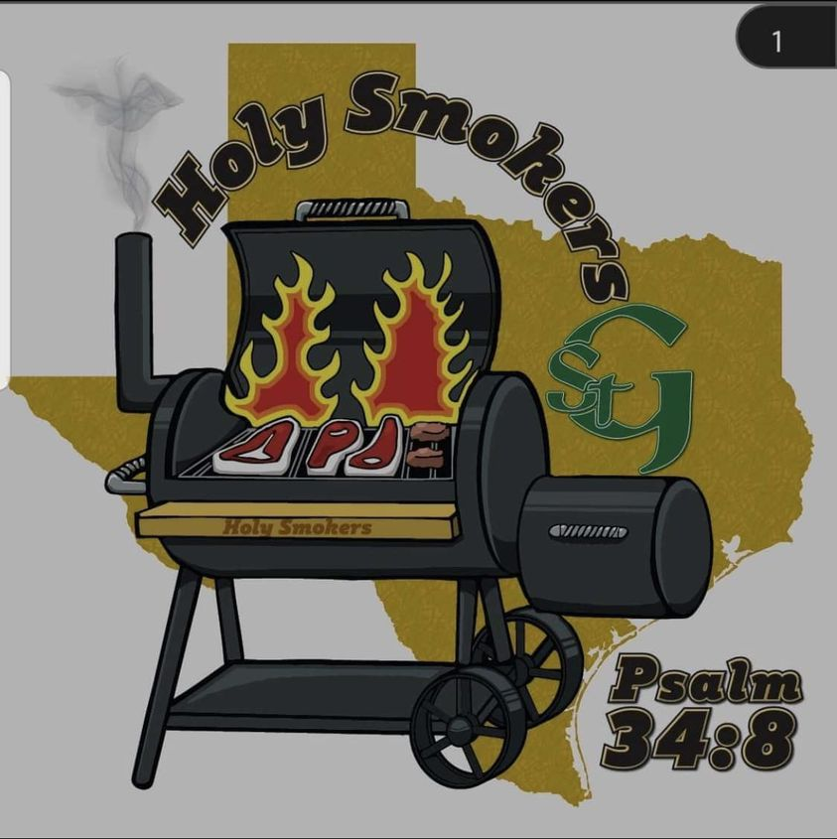

Slide 35
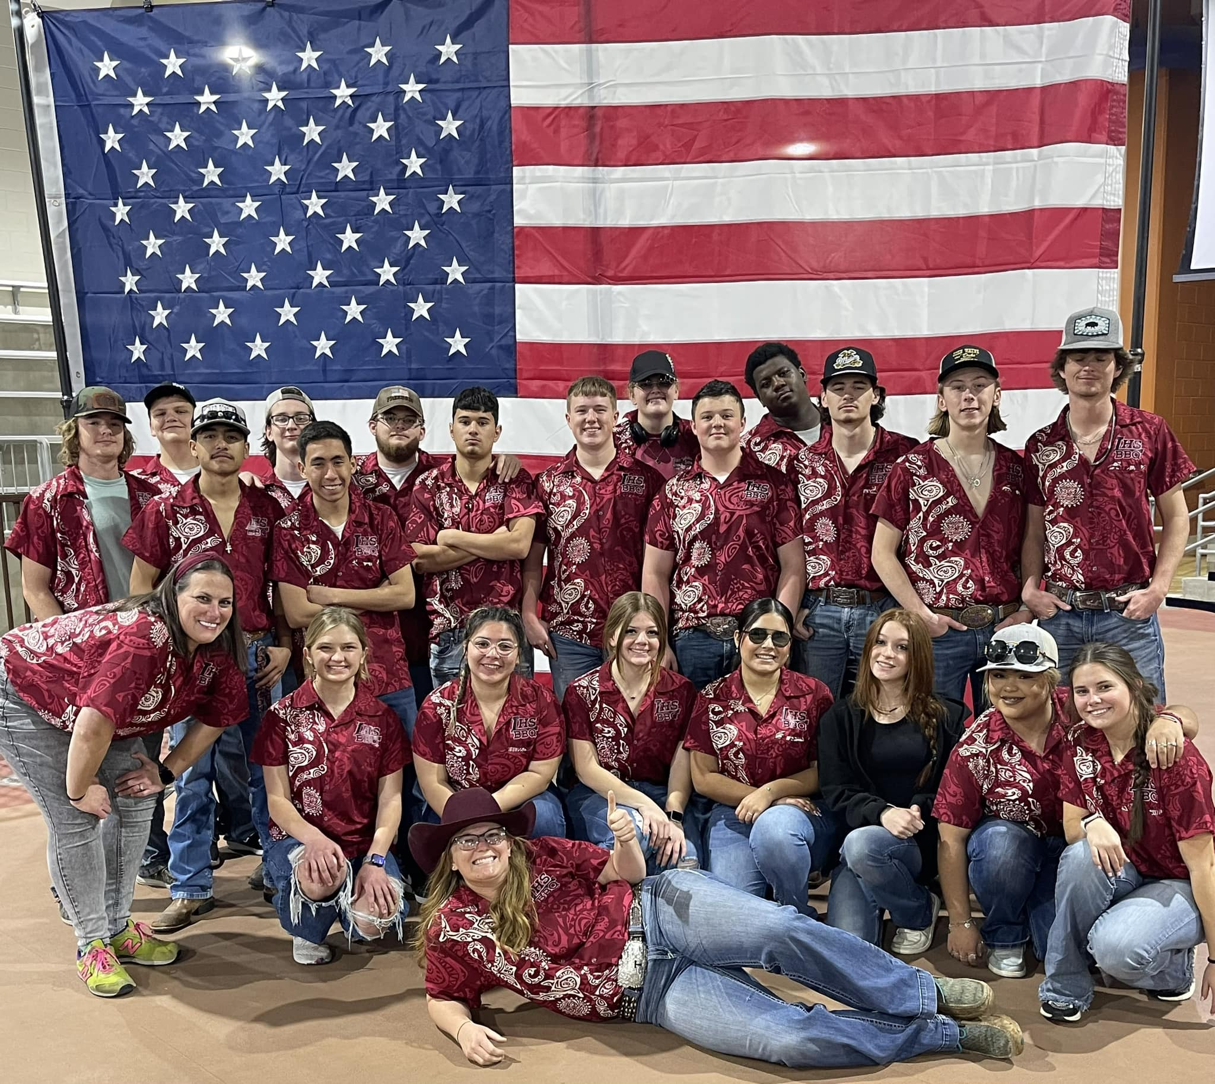

Slide 36
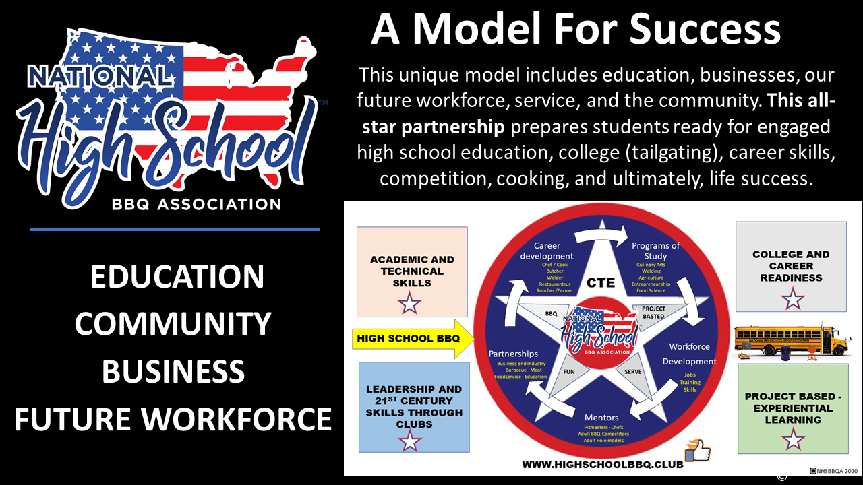
COLLABORATION

Slide 37
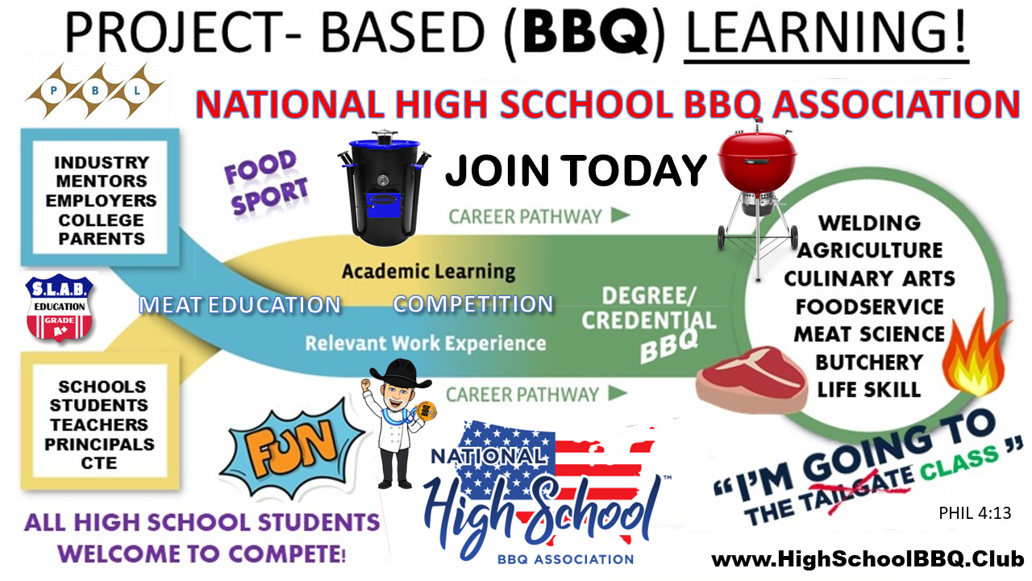
www.HSBBQ.ORG

Slide 38
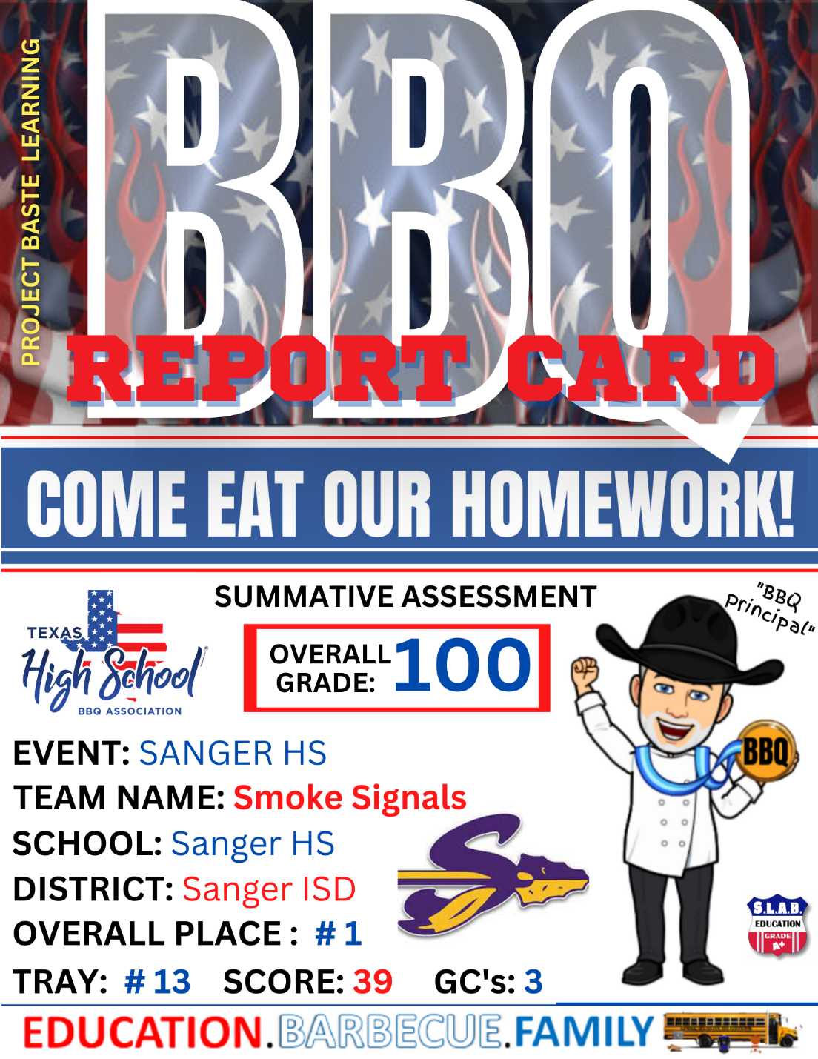
THE BBQ REPORT CARD

Slide 40
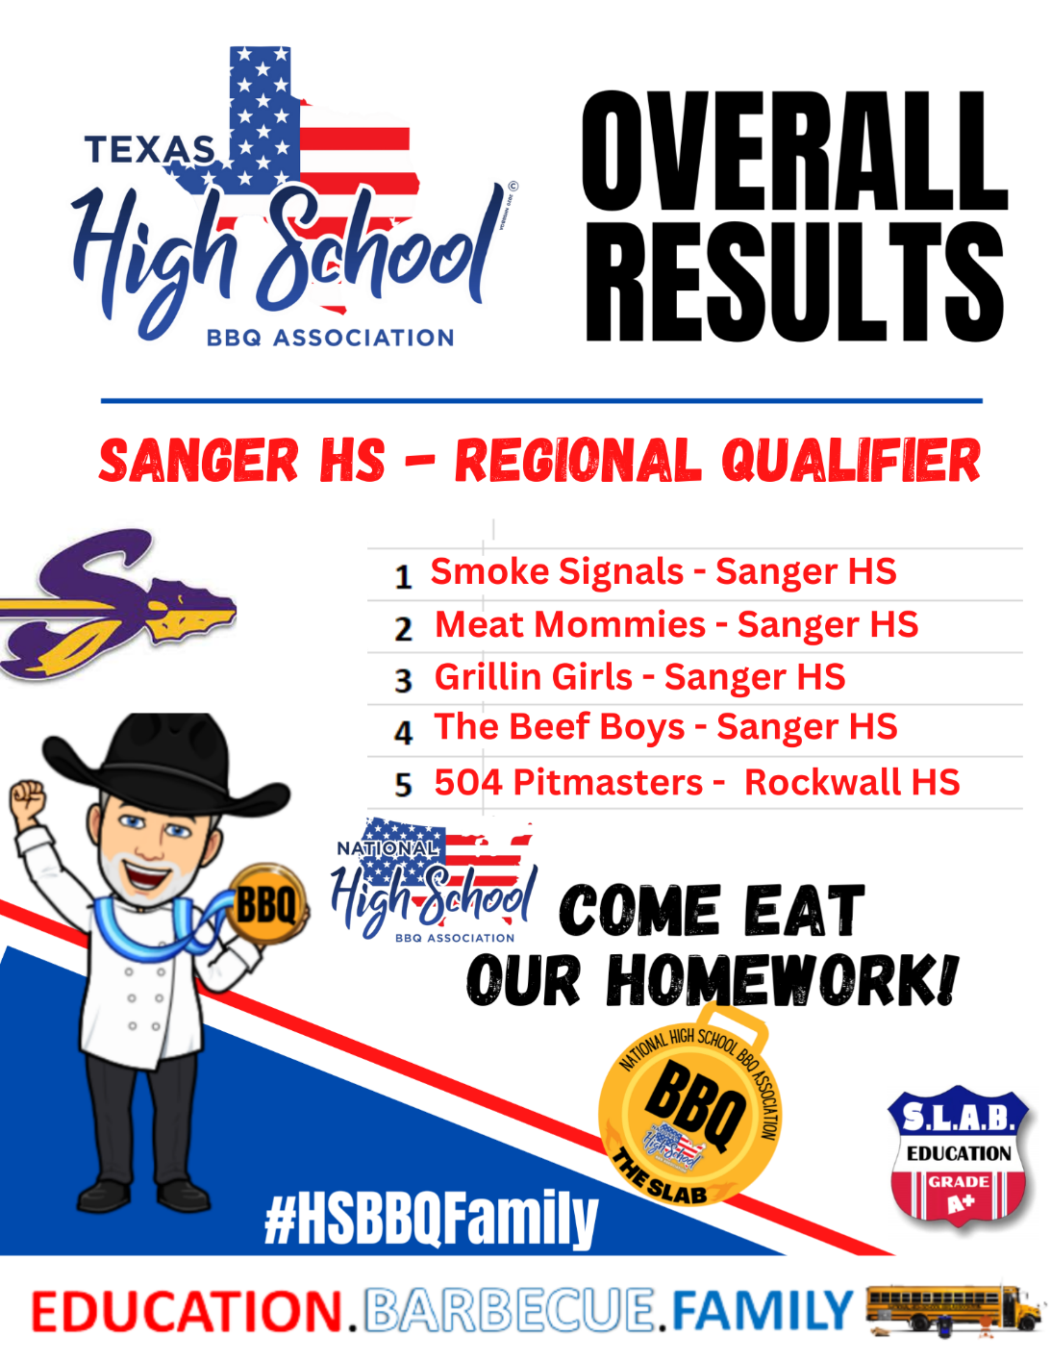

Slide 41
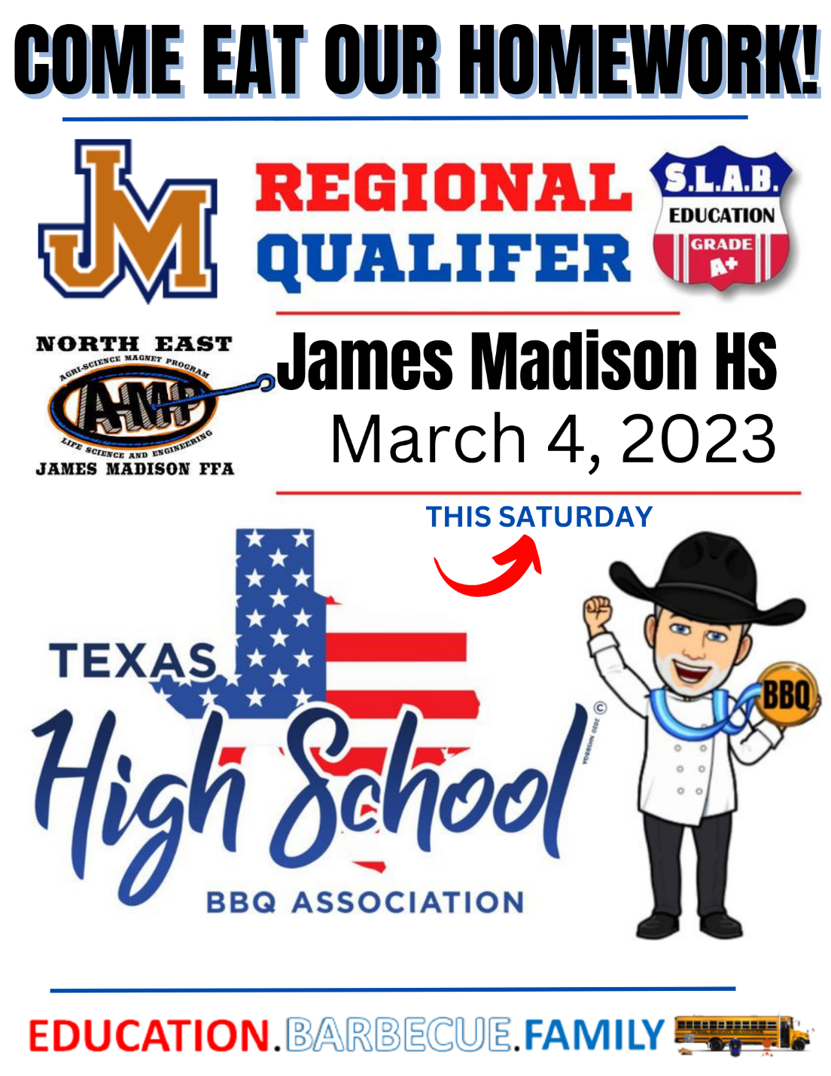
YOUR EVENTS

Slide 43
Why we are different?
The National High School BBQ Association (NHSBBQA®) and league is an activity that doesn’t discriminate based on popularity, athletic skill, gender, size, or academic ability. It’s a different kind of team sport. It’s open to any student or group of students. Its biggest supporters are professional educators because we were founded by teachers. Teams come together around one thing: Cooking and learn through Project Based Learning.
The NHSBBQA in the Schools Program is an in-school program aimed at improving educational performance among students in grades 7th – 12th. And through it, students are learning focus, self-control, discipline, patience, and the life lessons required to be successful in the classroom and in life.
BBQ Curriculum was written by BBQ Pitmasters, Chefs, and High School educators to meet State and National Standards. This enabled us to speak the language of educators who are intent on teaching core content throughout the school day. Our lessons are designed to be incorporated into many different content areas, career pathways, and align well with many Career and Technical Student Organizations.

Slide 45
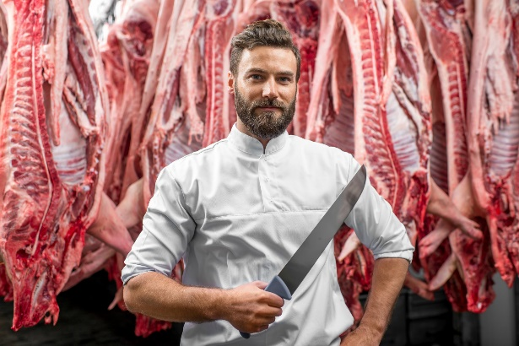
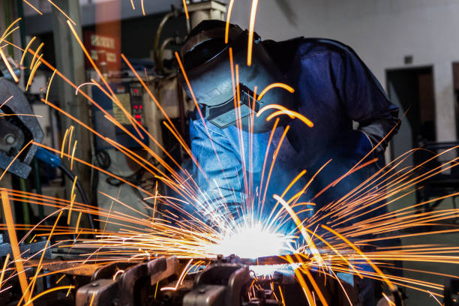
COME EAT OUR HOMEWORK!
T Teaching
A ABOUT
C CAREER
O OPPORTUNITIES

Slide 46
CERTIFICATION
State Director:

Slide 47
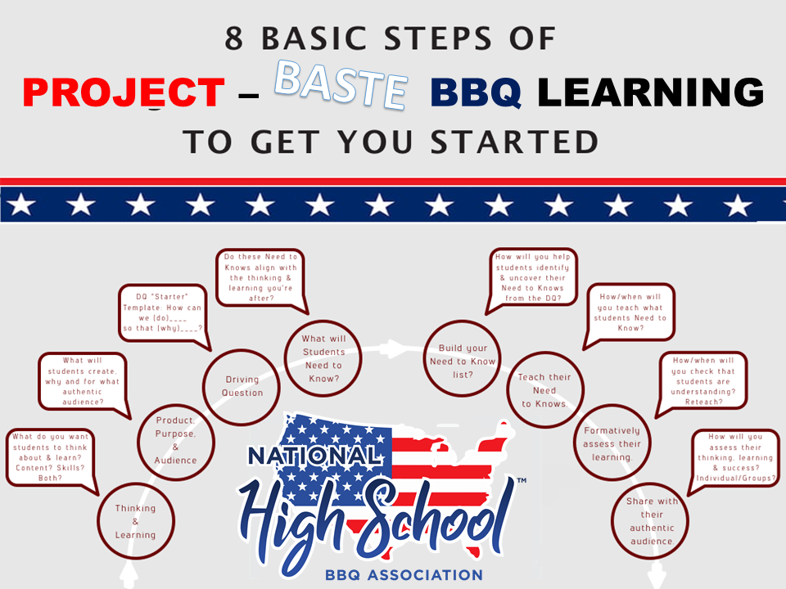
WHAT IS IT REALLY?
PROJECT BASED LEARNING DISGUISED AS A COOK OFF
Student Engagement
REAL WORLD!
COVER MANY NATIONAL ACADEMIC STANDARDS IN MANY PATHWAYS –
COOKING, GRILLING, SMOKING, ENTREPRENEURSHIP, WELDING, ENGINEERING, FOOD SCIENCE, CULINARY ARTS, AGRICULTURE, TEAM BUILDING, AND MORE.

Slide 50
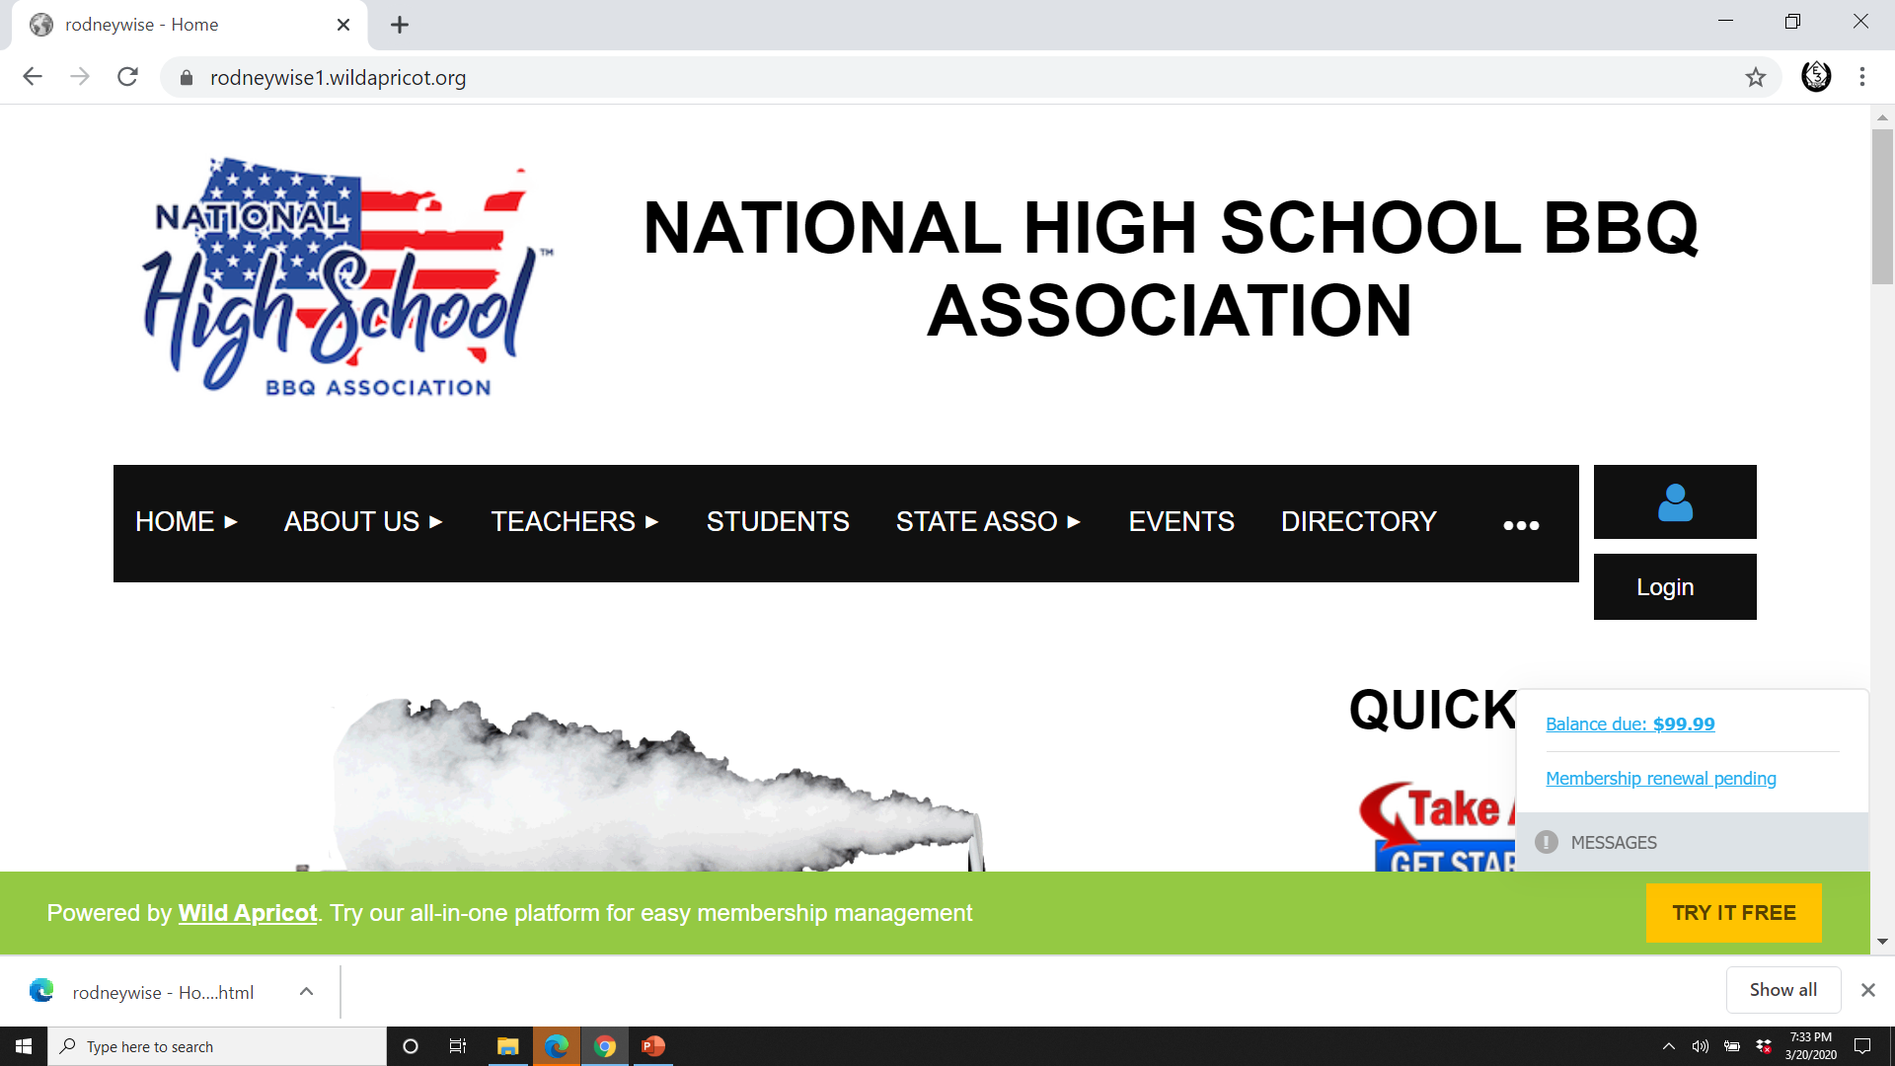
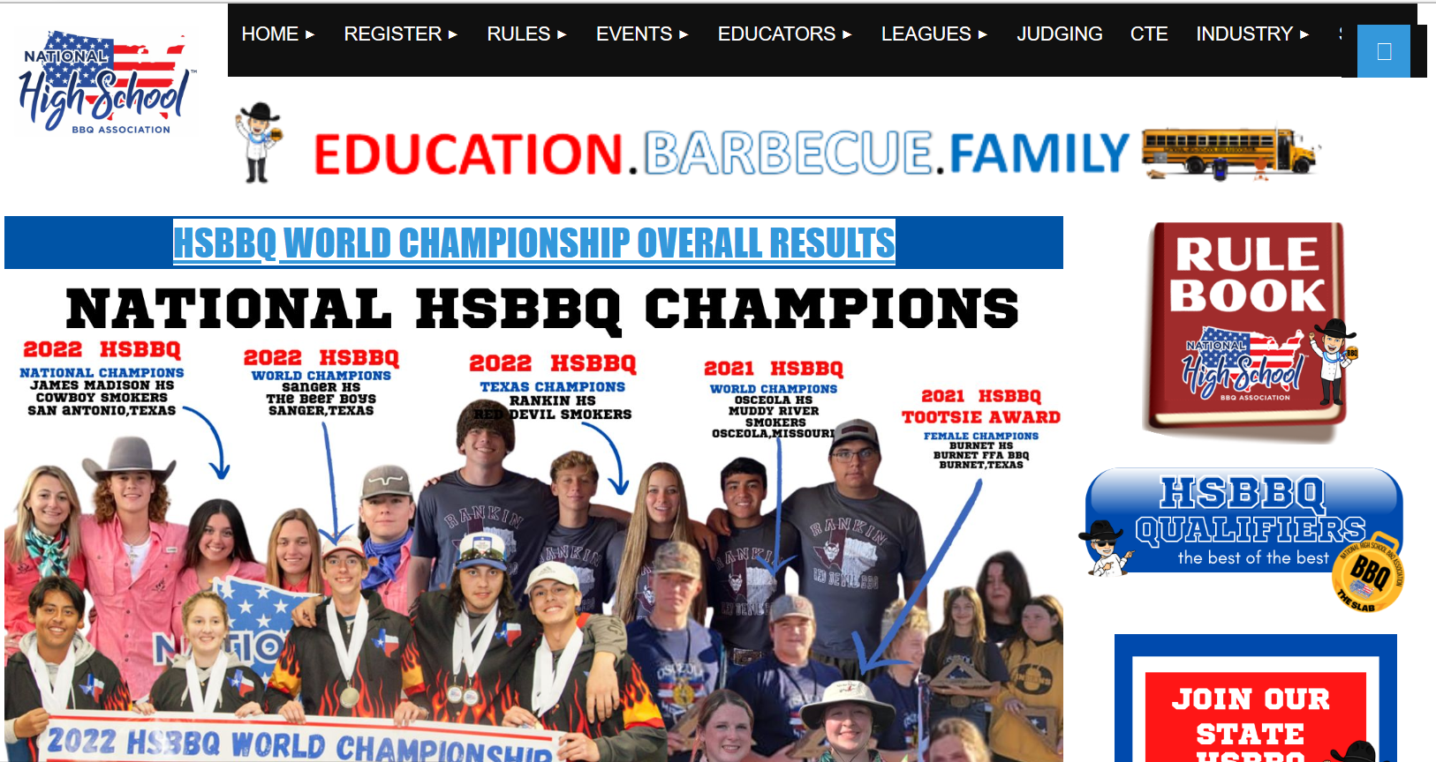
NATIONAL WEBSITE
WWW.HIGHSCHOOLBBQ.CLUB

Slide 51
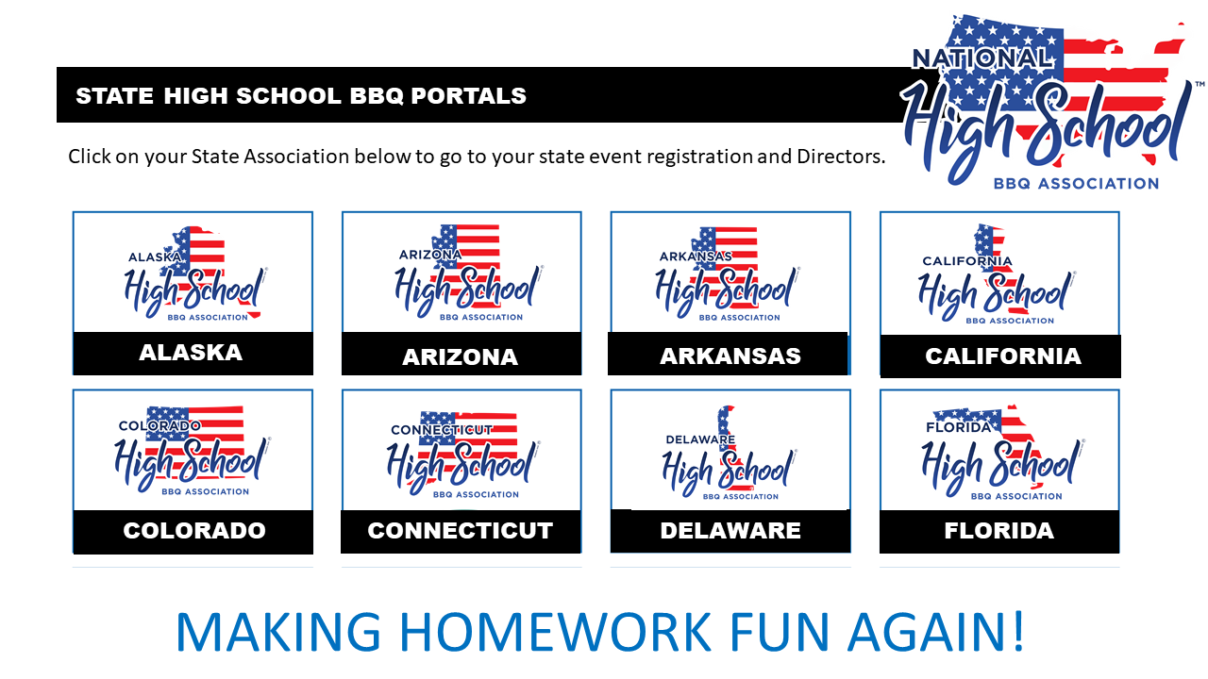
STATE BBQ ASSOCIATIONS

Slide 52
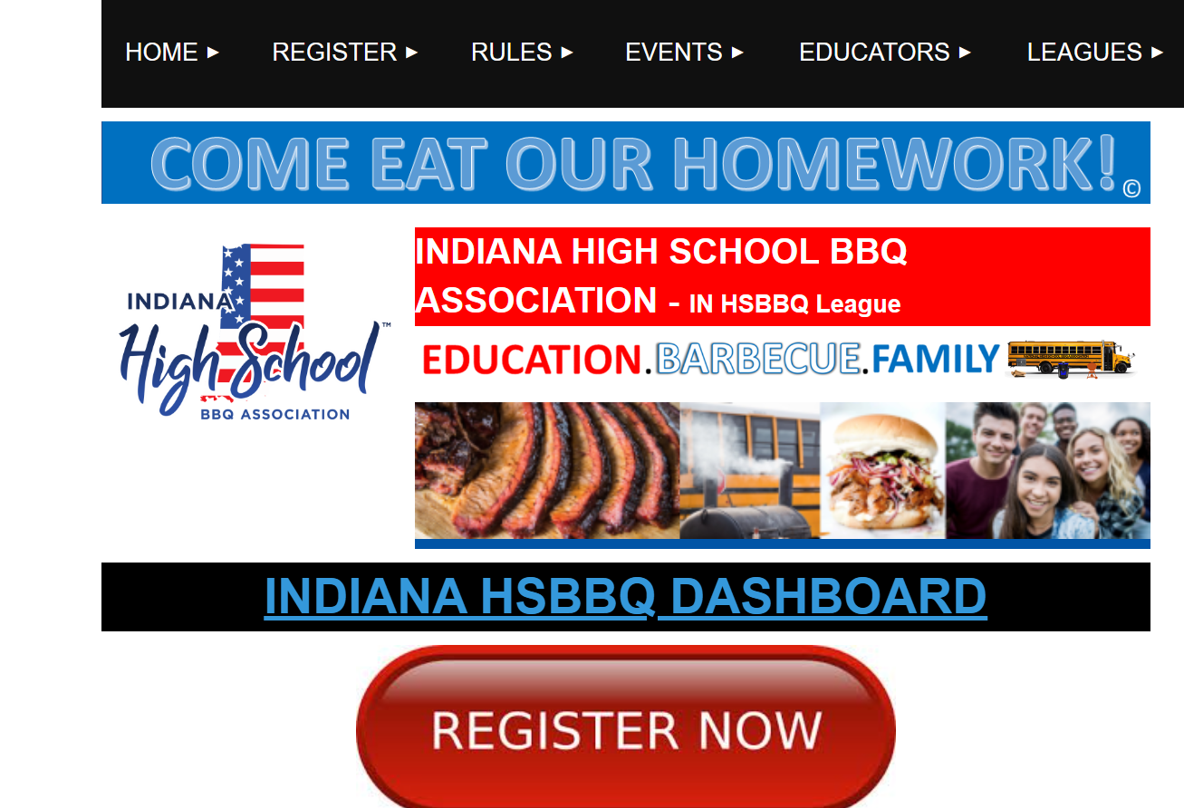
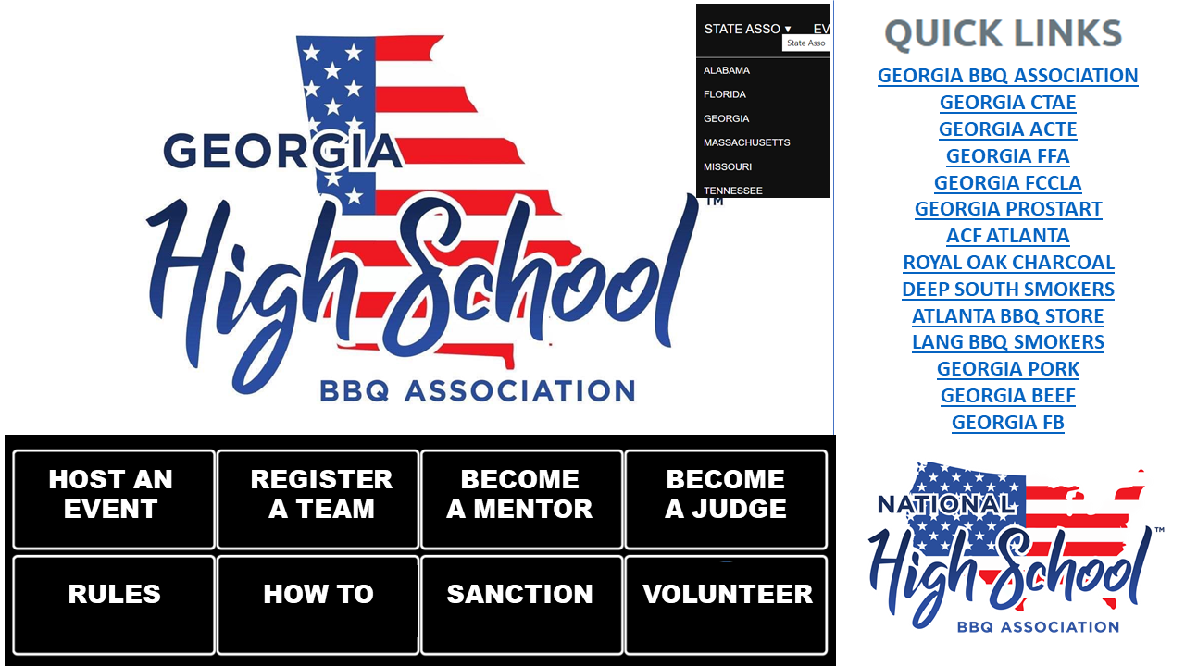
STATE WEBPAGE
WWW.HIGHSCHOOLBBQ.CLUB

Slide 53
MISSION STATEMENT
The mission of the National High School BBQ Association is to inspire and prepare students for
life by creating a nation-wide competitive league to teach, preserve, and promote the tradition
of barbecue and live fire cooking as a sport while using it to develop leadership, career, and life skills
for today’s youth.

Slide 54
VISION:
To become the premiere youth organization in America inspired by live fire cooking focused on Career and Technical skills development.
TAGLINE:
MAKING HOMEWORK FUN AGAINTM
MOTTO:
COME EAT OUR HOMEWORKTM

Slide 55
COME EAT OUR HOMEWORK!
E EDUCATION – Is the central focus of the National High School BBQ Association
A ATTITAINMENT – Achievement in a child’s life builds self esteem and character for ever.
T TRAINING – Cooking and leadership skills will serve these young people for life as they explore where their food comes
from and what makes quality food and meat.
B BARBECUE – Is a cooking technique that teaches patience, time management, planning, exploration, teamwork, passion,
focus, culinary skills, creativity, public speaking, collaboration, and much more.
B BRAVE – Perseverance, grit, and determination creates better citizens and Americans.
Q QUINTESSENTIAL – BBQ, Friends, fellowship, fire, are MAKING HOMEWORK FUN AGAINTM

Slide 56
STUDENT ORGANIZATIONS
FFA / 4-H
ProStart
FCCLA - Family Community Leaders of America
National Restaurant Association ProStart Program
Skills USA
Boy Scouts of America
Other Campus student groups

Slide 57
CHAMPIONSHIPS (SUMMATIVE ASSESSMENT)

Slide 58
THE SLAB
STUDENTS LIT ABOUT BBQ!
A.K.A.
COMPETITION
WE LOOK FORWARD TO SEEING YOUR SCHOOL AT STATE OR NATIONALS!
PRESENTS:

Slide 59
T
having been ignited; burning.
2. provided with light or lighting; illuminated.
L I

Slide 60
STATE ASSOCIATION AND ACHIEVMENT PATCHES
Missouri

Slide 61
CAN YOU LETTER IN BBQ? YES VARSITY LETTER JACKETS

Slide 62
COOK OFF REGIONS

Slide 63
HOW? What is a High School BBQ Club?
-
A High School BBQ Club is a group of young people dedicated to learning how to become better Americans and cookers through the art of bbq while inspiring fellowship, service, competition, teamwork, camaraderie, learning, hard work, research, practice, dedication, networking, public speaking, and American GRIT.

Slide 64
What is a High School BBQ Team?
-
A high school bbq team is a group of high school students (maximum 5) that come together to compete in a bbq cook off preparing 5 different food items. The items include – Pulled Pork, Ribs, Chicken, Steak, and Dessert for scholarships, prizes, and bragging rights............very important in America!

Slide 65
What does a High School BBQ Club or team do?
-
Promotes education
Keeps kids in school and career pathways – Culinary Arts, Welding, Ag
Creates formal service group on campus to serve the campus and community
Enhances fundraising potential
Creates and strengthens relationships
Strengthens community and industry bonds
Showcases students in public
Creates scholarship opportunities

Slide 66
EVENT SCHEDULE
8:00 A.M. ARRIVE FOR SET UP
8:45 A.M. PLEDGE / PRAYER
9:00 A.M START FIRES
9:30 A.M. PASS OUT MEATS
1:00 P.M. DESSERT TURN-IN
2:00 P.M. STEAK TURN- IN
3:00 P.M. CHICKEN TURN-IN
4:00 P.M. RIB TURN-IN
5:00 P.M . PULLED PORK TURN –IN
5:30 P.M. CLEAN UP
6:00 P.M. AWARDS CEREMONY
SUGGESTED
TURN-IN
TIMES
STATES
MAY VARY

Slide 67
The Equipment (See our Equipment Checkoff List)

Slide 68
WHAT DOES A COOK OFF LOOK LIKE?

Slide 69
SERVE YOUR COMMUNITY TEAM BBQ is an exclusive High School BBQ group of students who have earned the patch and affiliation by serving their community.
DISTASTER RELIEF
FEED THE HUNGRY
COMMUNITY SERVICE
SERVE YOUR CAMPUS
SERVE YOUR FCCLA CHAPTER
FUNDRAISE FOR A NON-PROFIT
SERVICE

Slide 70
School District Pit Many School Districts build or purchase a competition pit and keep it at the Bus Barn with the fleet vehicles for check out and use by anyone in the District.

Slide 71
THE FOOD

Slide 72
FOOD SAFETY CERTIFICATION CLASS
REQUIRED FOR ALL TEAM MEMBERS
National Restaurant Association Food Handlers or Managers Certificate
State Food Safety Certification Class
Online Class or School
( Must provide a copy at the Cook Off Event)
Some type of State Food Safety Certificate

Slide 73
FIRE SAFETY AND PIT MENTORS

Slide 74
FIRE SAFETY AND PPE
Personal Protective Equipment Team Kit –
1 of each
First Aid Kit
Welding Mask and or protective eye cover
BBQ / WELDING
HIGH HEAT GLOVES
Food Safe
Gloves
Insulated BBQ Coated Gloves
Iron Fire Pit tongs /poker

Slide 75
Attractions – vendors , college fair, welding exhibition, food, speakers, and a concert

Slide 76
WHAT ARE THE NEXT STEPS?
GET PRINCIPAL APPROVAL
FIND A TEACHER ADIVSOR
FIND A MENTOR
REGISTER YOUR SCHOOL
CHOOSE YOUR EVENT
REGISTER YOUR TEAM
REACH OUT TO YOUR COMMUNITY
PRACTICE
COMPETE!

Slide 77
WHAT STATE WILL BE THE 2024 NATIONAL CHAMPION?

Slide 78
CONTACT US
National High School BBQ Association, Inc.
National High School BBQ Association
Chef Mike Erickson –
National Director/ High School Teacher
principal@HighSchoolBBQLeague.com
(512) 629-7357
Start A Fire Burning In A Child’s Life!
WWW.HSBBQ.ORG

Slide 79
FREE BARBECUE

